Slide 1


2023
UKRAINE’s
SCALA COMMUNITY BUILDING LESSONS
Scala

Slide 2

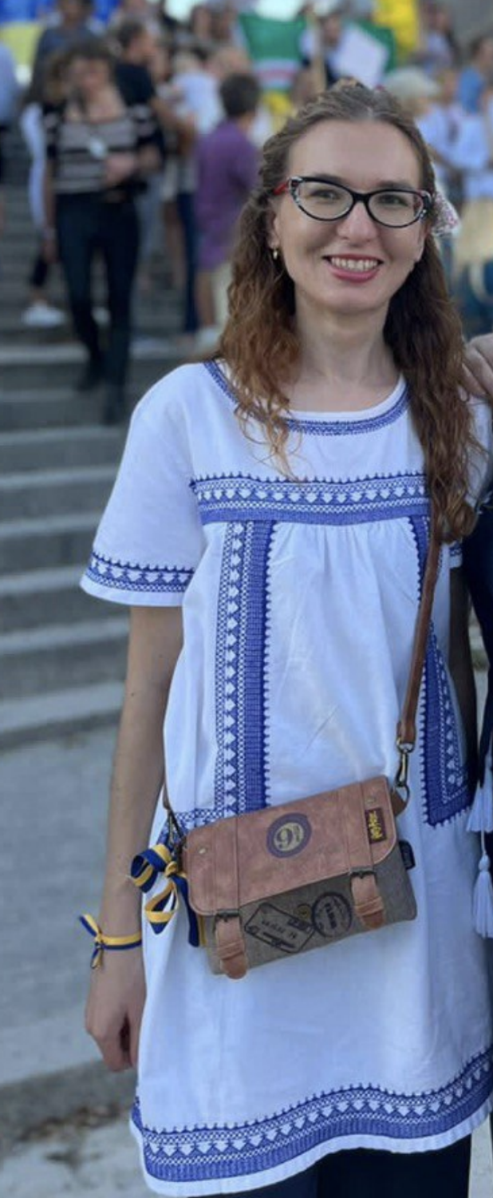


Olga Mazhara
10 in programming
5 in Scala
5 in teaching
Engineer and Scala community leader at Intellias
1.5 in teaching Scala
Worked as a functional programming instructor at Igor Sikorsky Kyiv Polytechnic Institute
Scala

Slide 3






Scala Ukraine timeline
Scala UA conference
Community born
Meetings in the IT tent during the revolution
Scala UA first meetup
Scala + Akka workshop Kyiv, Scala Core workshop Kharkiv , FP Monands on Exotic Meetup, ScalaUa - 3 meetups, Advanced Scala course by Alex Nemish, java-scala labs Odesa
Scala Luxoft meet-ups by Alex Nemish
2011
2012
2013
2014
2015
2016
Odesa regular meetups
Scala course in Kharkiv university
First course in KPI university by Ruslan Shevchenko
java-scala labs Odesa, ScalaUa - 2 meetups
ScalaUA, Java/Scala Lab Odesa, ScalaUa - 1 meetup, Advanced Scala course by Alex Nemish, Scala course by Ruslan Shevchenko
scala-koans code retreat in Odesa, Scala UA - 3 meetups,

Slide 4

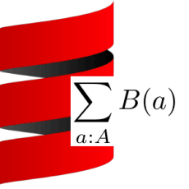


Covid and post covid times
Kyiv Scala group by Evaldas Miliauskas
Intro to programming with dependent types course by Dmytro Mitin
Kyiv university Scala course
Kyiv Scala group 2 meet-ups, Scala UA, Intellias Advanced Scala CodeSpace Scala course
3 Kyiv Scala group meetups, 2 Kyiv Scala group workshop, FP Advanced Scala course by Alex Nemish
2 Kyiv Scala group online meetups
2017
2018
2019
2020
2021
Feb 2022
Scala UA in person
Scala UA conference online
Scala Ukraine group
9 Kyiv Scala group meet-ups, Advanced Scala course by Alex Nemish
2 Kyiv Scala group online meet-ups, 2 Scala trainings by Dmytro Mitin
Scala Ukraine meet-up, Google Summer code

Slide 5
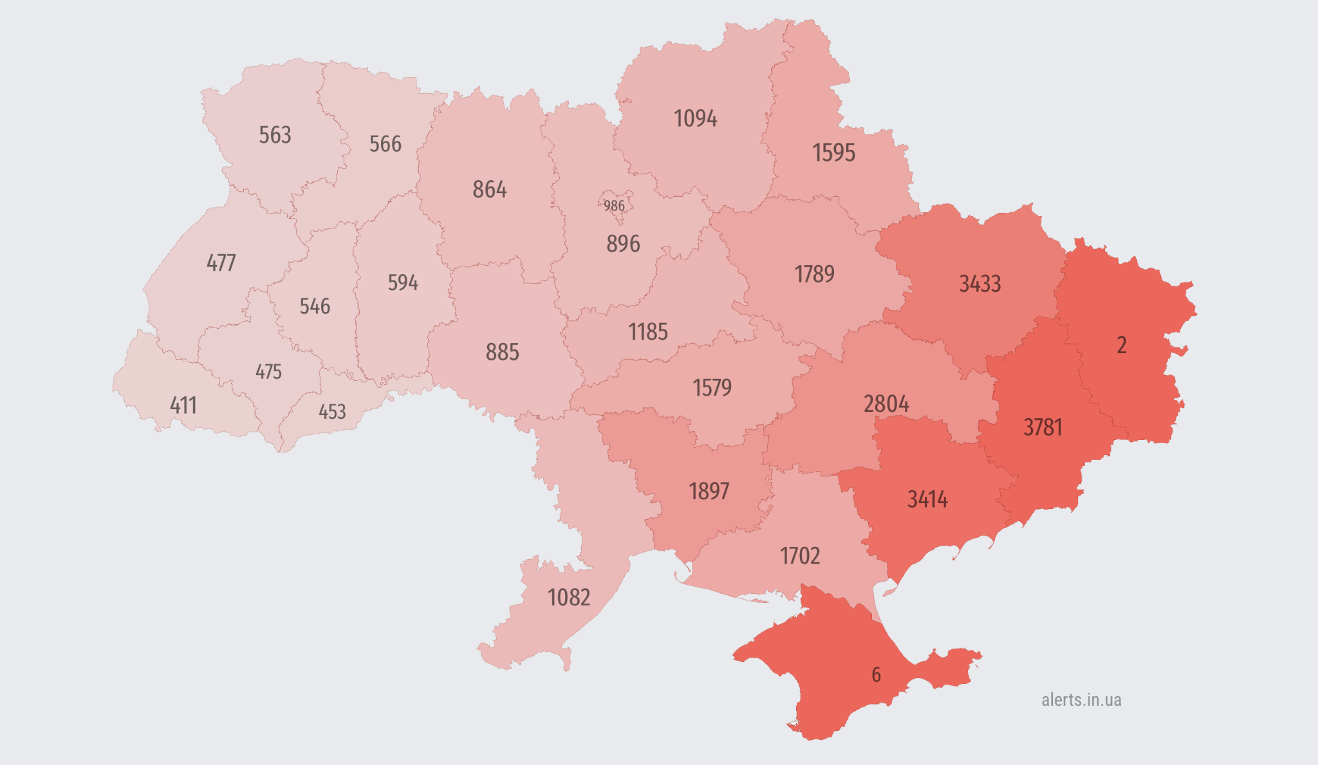

Air alert number by region
since Feb 24 2022

Slide 6

Challenges
Dangerous to meet
We moved to different countries
Emotional burnout
Market decline

Slide 7
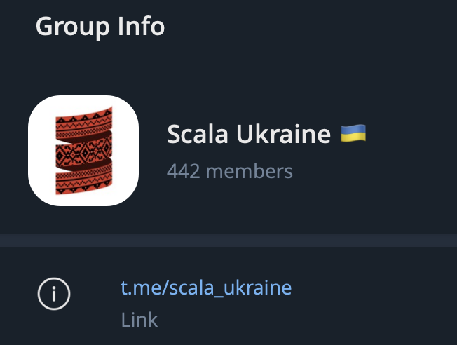
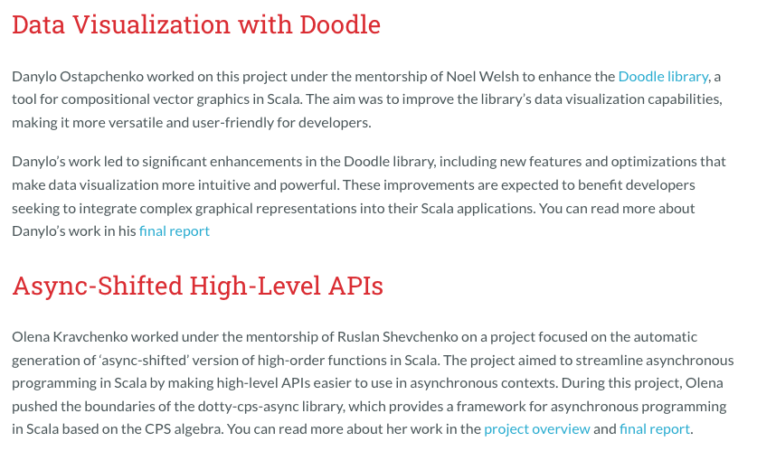
What worked out?
Google summer code project
1 group, 442 members
https://www.scala-lang.org/blog/2023/12/20/gsoc-report.html

Slide 8
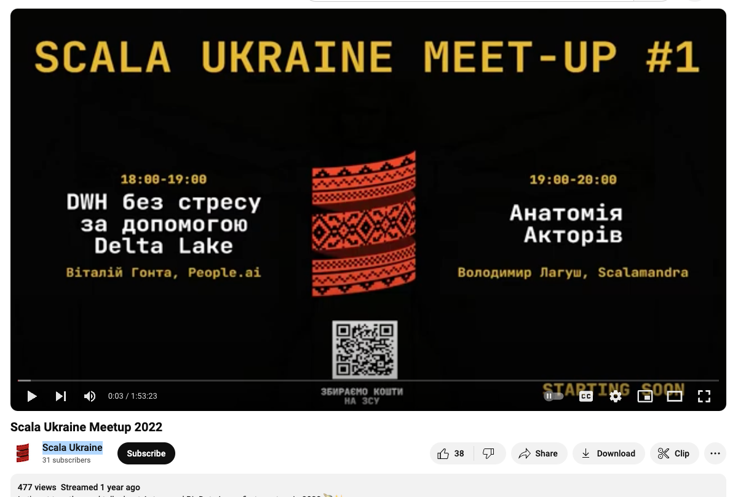
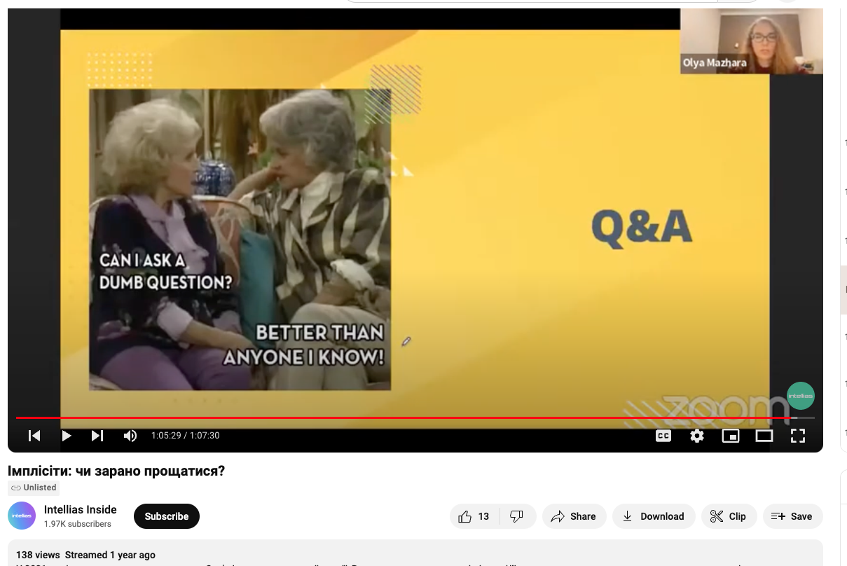
What did not and why?
1 meetup, 477 views
1 webinar, 138 views

Slide 9

Problem: too big too soon
Scala

Slide 10
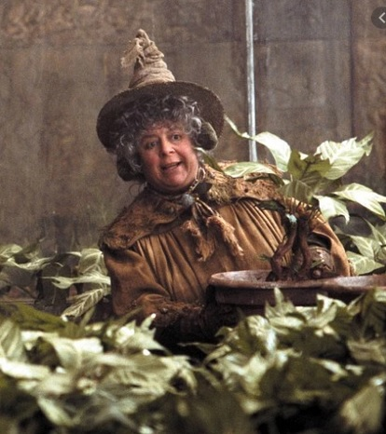
Try it small first
Ingredients:
mentors, leaders, moderators
persistence & regularity
common subject (project, open source, courses, interview preparation, book clubs)
minimum requirement for participation
easy way to join and left community
Scala
https://variety.com/2023/film/news/professor-sprout-miriam-margolyes-harry-potter-not-important-1235642850/

Slide 11
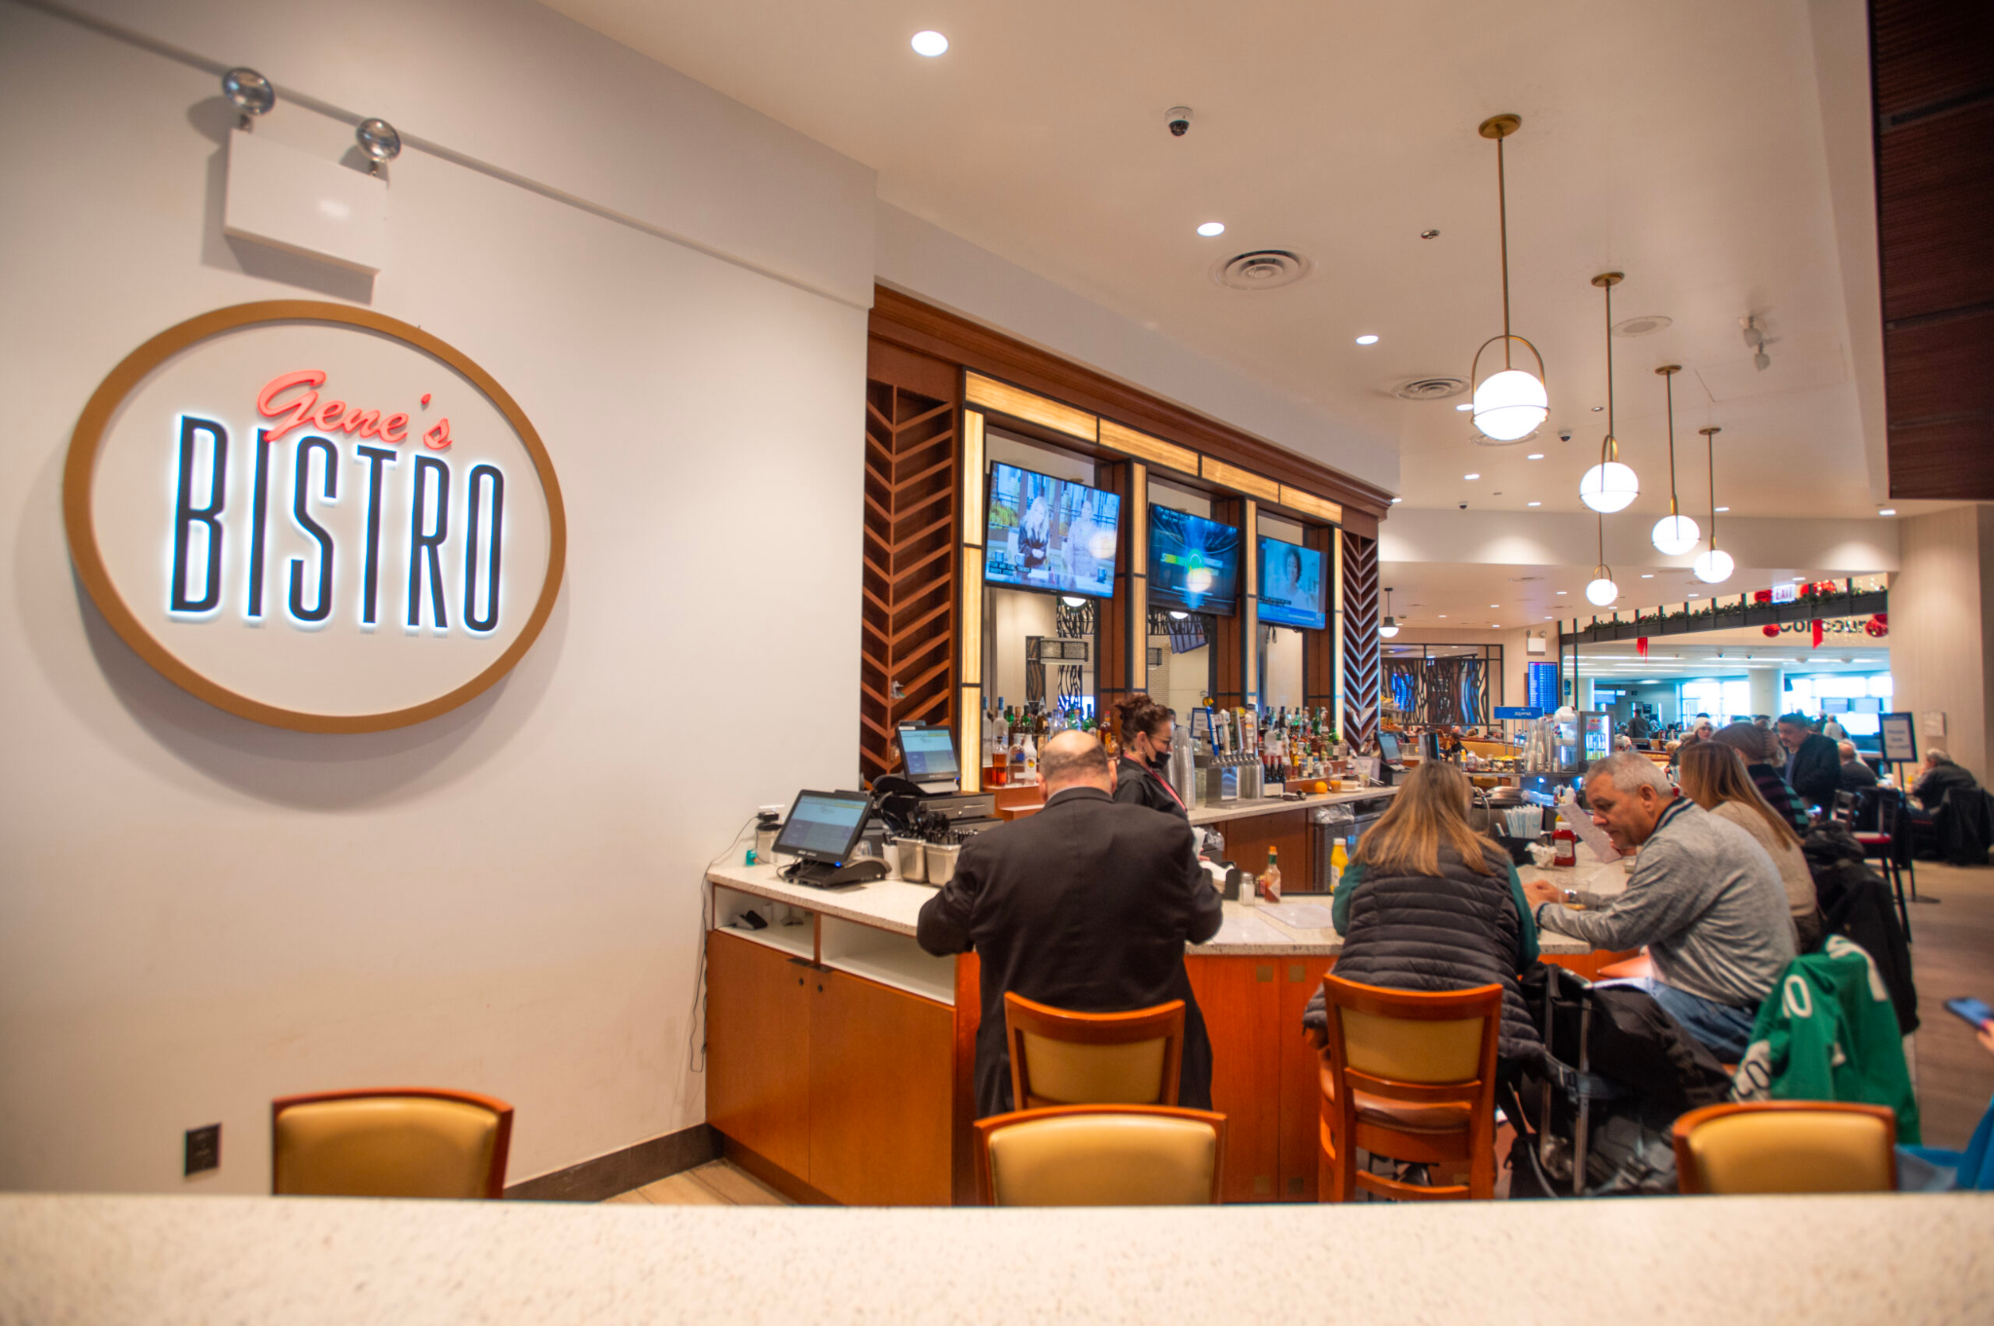
Scala Book Club
i’ll be there for you
it is there for you wherever you are because it is online
same place, same time
you know what to expect
no need to dress up :)
Scala
https://www.midwaypartnership.com/businesses/genes-bistro/

Slide 12

Rules
It CAN NOT be canceled
We do not accept people from terrorist states
Scala

Slide 13



What it means for attendy
what do you mean that is only one rule?
You don't have to read the book
You can be late
There is no such thing as a stupid question
You can be silent or be sunshine of meeting - it is up to you
Everything is optional, but me waiting for you every wednesday at the same time

Slide 14

What it means for moderator
You should NOT be smartest person in the room
You should NOT over prepare for meeting
What should I do?
Ask questions! if you do not get it, you have group of smart people around it is stupid not to ask
Lets them talk about
if you do not want to read choose topic you can talk about 1 hour, they are fine with it, they have not read as well))

Slide 15

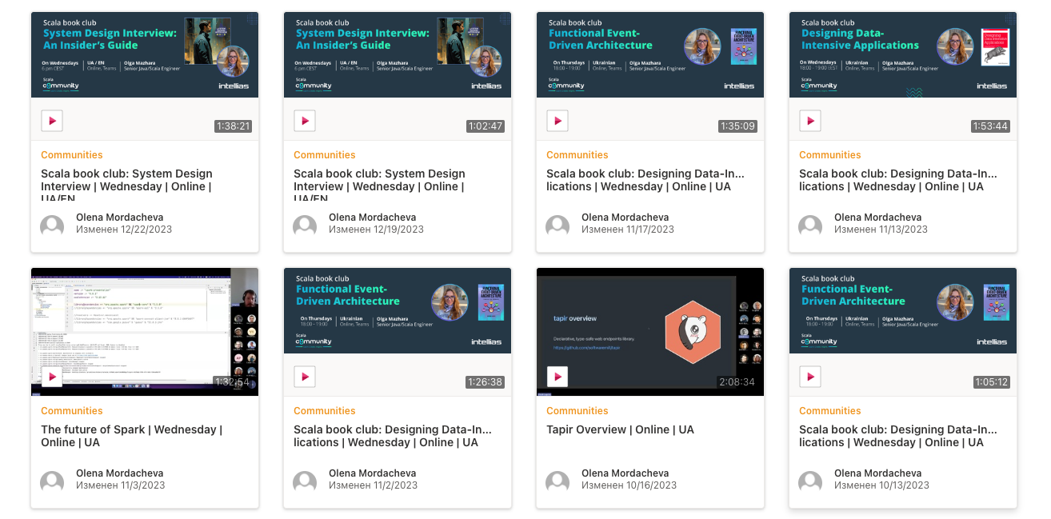
Scala Book Club
45 meetings
3 talks
Scala

Slide 16
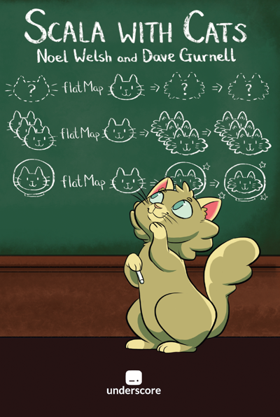




Scala Book Club
5 books
Scala

Slide 17
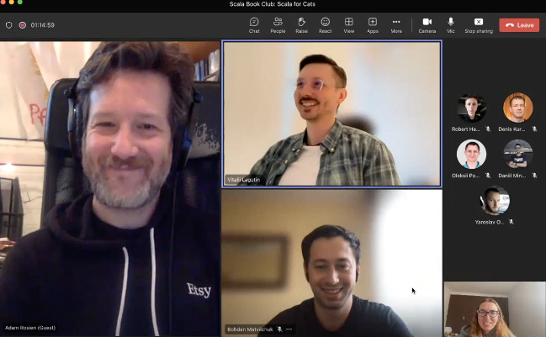
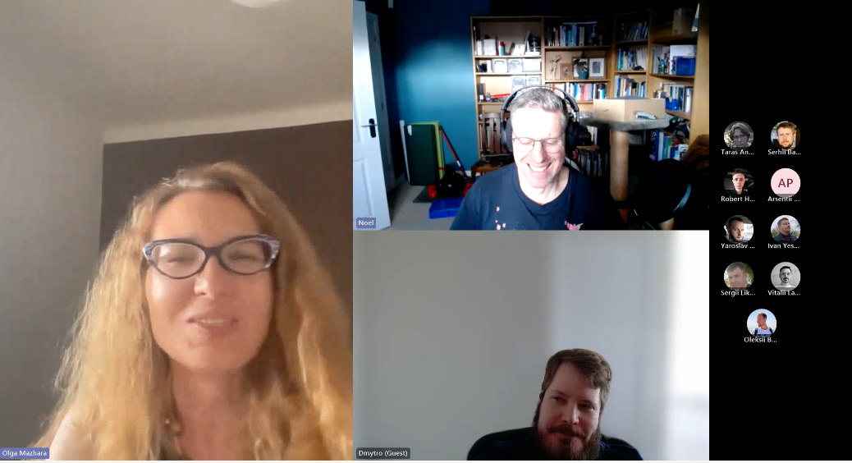
Scala Book Club
authors visiting
Scala

Slide 18
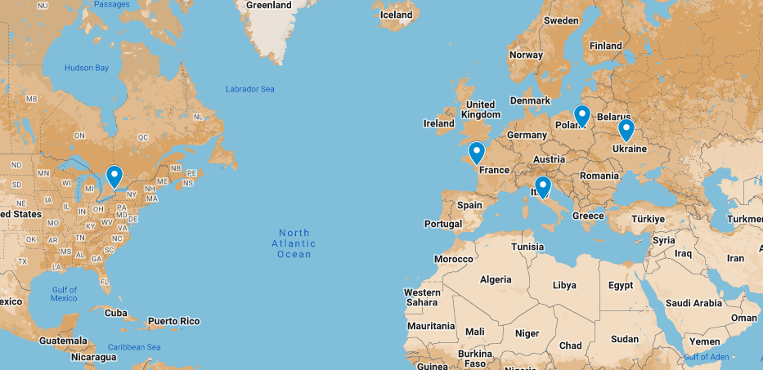
Invite the person not a group
Grow slowly
Notes:
not limit to your company - if you can lose you workers because of bookclub - you company sucks , but you can give you team more - videos, bonuses, etc
invite person not group,if you grow slow new people assimilate , otherwise - you make it comfortable => 2 new speakers,
we respect our guests and members, so if english is our common language - do not be shy, say hello and we gonna switch , but we do not make accommodation in advance so it is up to you to inform about your presents

Slide 19
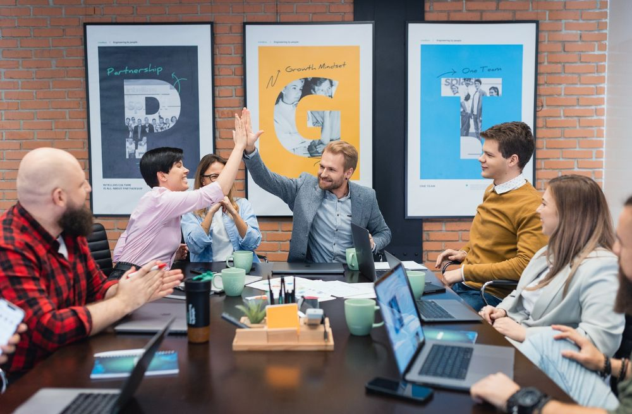
Your involvement in the book club doesn't end with your engagement with the company

Slide 20
Collect individual feedback
"It's been a while since I've seen you on Book Club. What's up?
Book is to difficult
to theoretical
I go to gym at the same time
Book is too simple
it’s boooring…
why should i go at all?
mother in law is visiting us
I wish to see more practical staff
bla bla… how to apply this book?

Slide 21

Collect individual feedback
"It's been a while since I've seen you on Book Club. What's up?
Book is to difficult
to theoretical
I go to gym at the same time
Book is too simple
why should i go at all?
it’s boooring…
I wish to see more practical staff
mother in law is visiting us
react on feedback but not try to please everyone
bla bla… how to apply this book?

Slide 22

What we have tried
Pet project
just 1 person worked on it
difficult to organize people
we have enough work at work
but we have a lot of new inner jokes about it :)
Scala breaks
Open source

Slide 23

What we have tried
Pet project
just 1 person worked on it
difficult to organize people
we have enough work at work
but we have a lot of new inner jokes about it :)
Scala breaks
add other talks and topics between chapters
prepare some interview like tasks to discus
share some news from Scala word
talk about completely random staff
Open source

Slide 24

What we have tried
Pet project
just 1 person worked on it
difficult to organize people
we have enough work at work
but we have a lot of new inner jokes about it :)
Scala breaks
add other talks and topics between chapters
prepare some interview like tasks to discus
share some news from Scala word
talk about completely random staff
Open source
some members already contributors
could be used as offline meet up activity

Slide 25

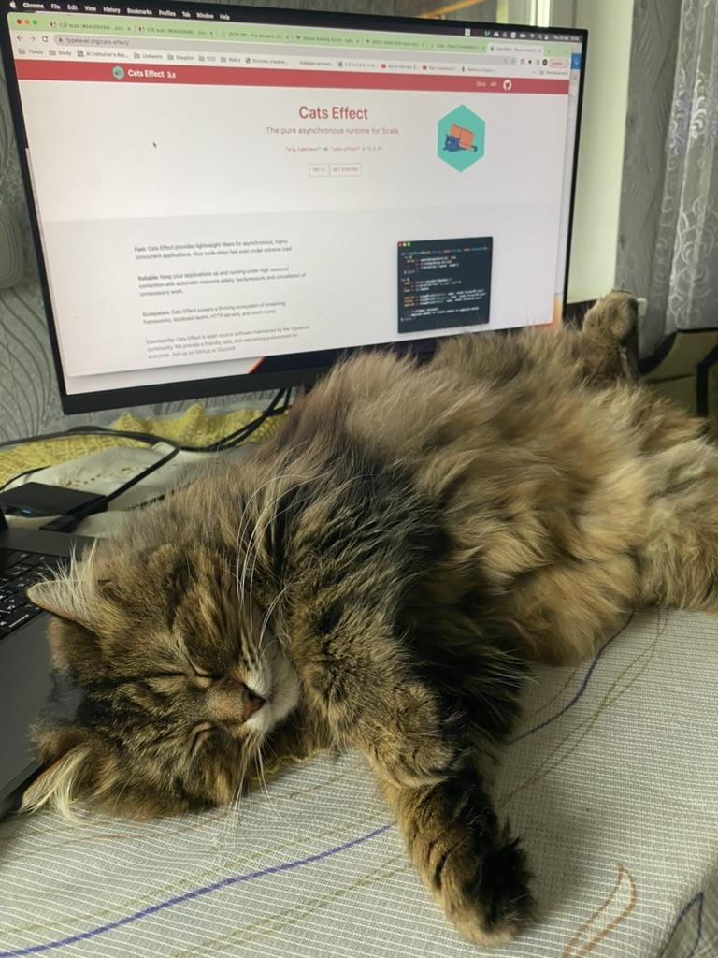
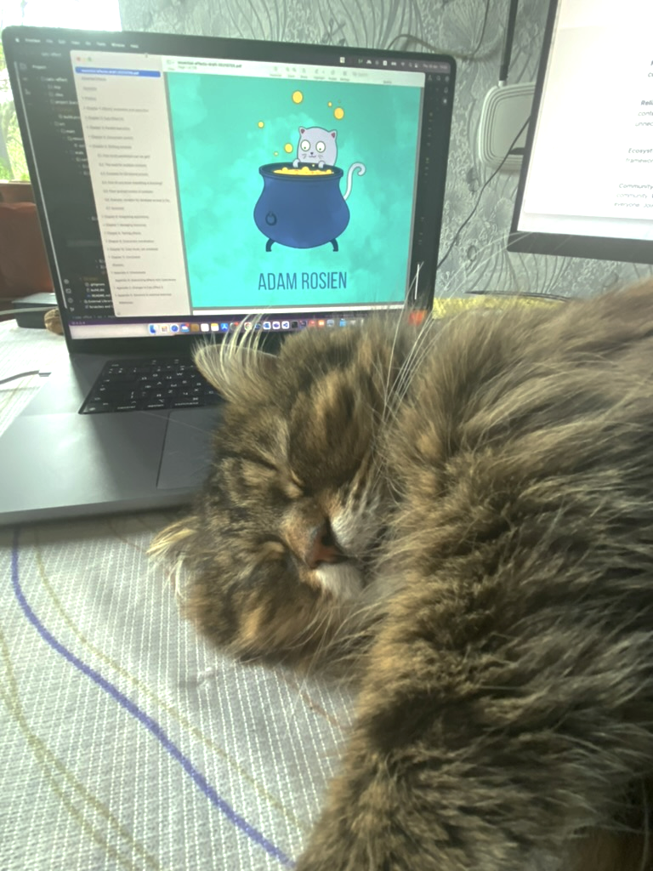
Know your people
They do not talk and it is fine

Slide 26
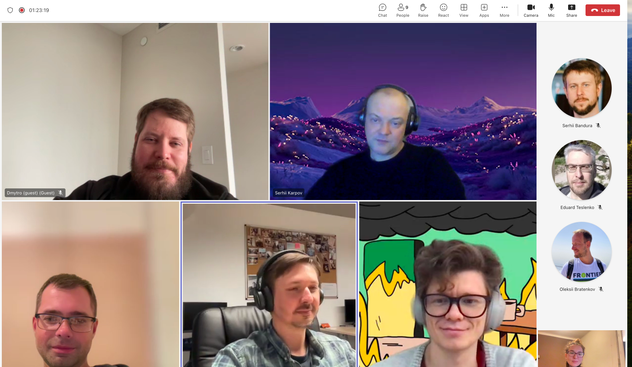
Know your people
They do not talk and it is fine
Cameras turned off - OK!

Slide 27
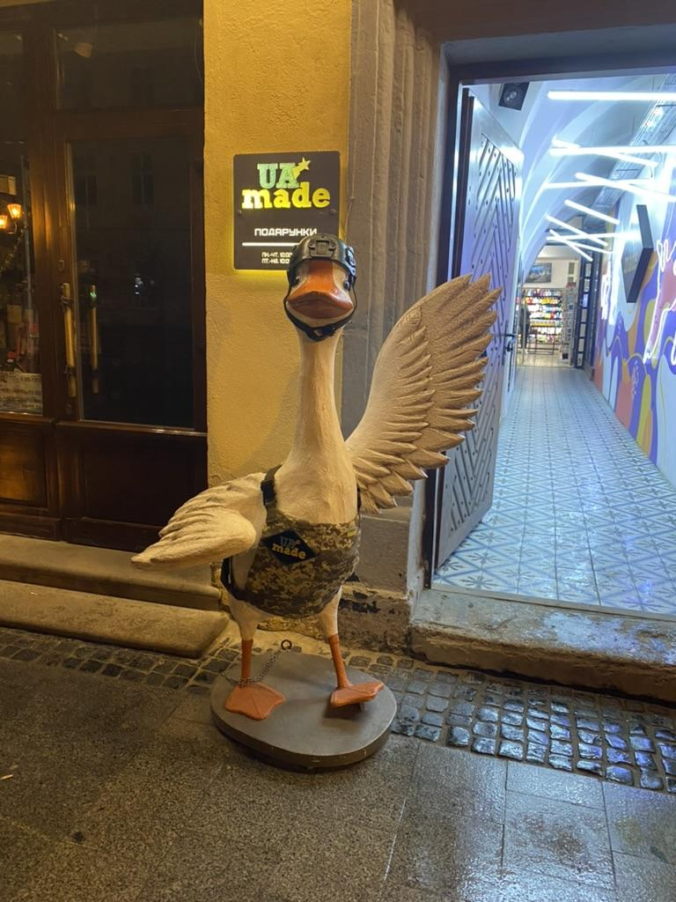
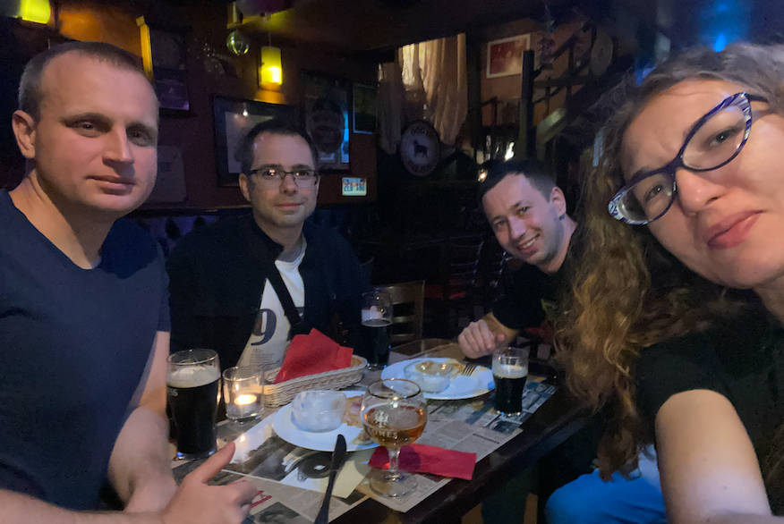
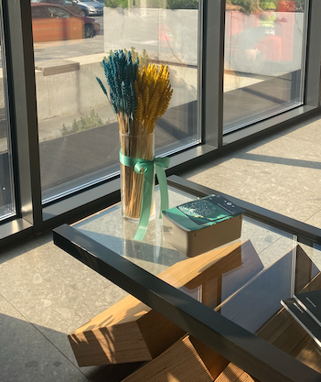
Know your people
They do not talk and it is fine
Cameras turned off - OK!
if you can - meet them in personal
and yes, you can visit 3 city in 2 different countries city to meet people who go to your book club and take 1 photo with them :)

Slide 28
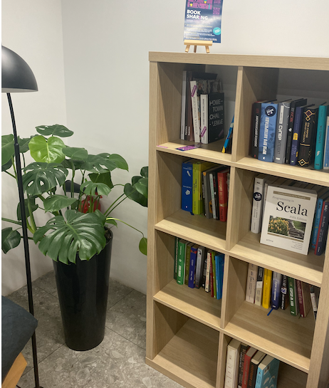
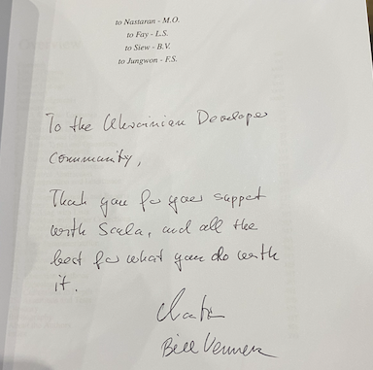
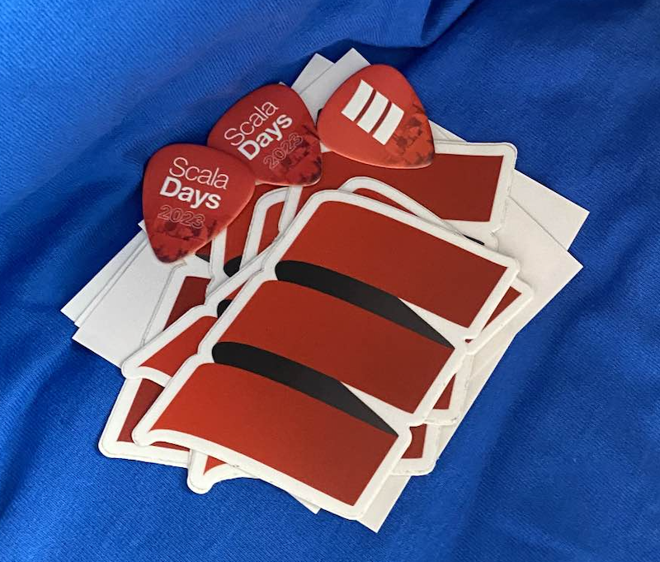
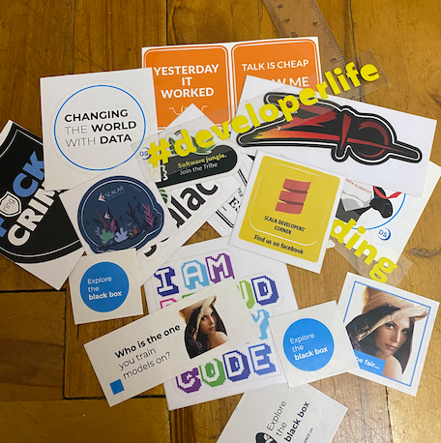
Know your people
They do not talk and it is fine
Cameras turned off - OK!
if you can - meet them in personal
money is bad motivation, but people likes stickers and presents

Slide 29
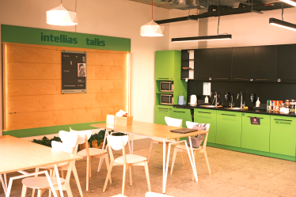
Give them access to your kitchen and observe

Slide 30

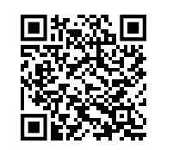
THANKS!
loveslides.com

